Slide 1

CUSTOMER
SEGMENTATION
ANALYSIS
By Sai Swapna,
Mishty,
Divyanshu Sharma,
Naga Charanya,
Soundarya
Bharani Kumar
Team-2

Slide 2

INTRODUCTION
This analysis focuses on customer shopping trends to understand behavior patterns.
The goal is to uncover key insights that can drive data-driven marketing strategies, customer retention, and sales growth.
The project aims to analyze customer preferences and purchase behaviors

Slide 3

Power BI - Data Visualization Tool
Create Interactive Dashboards
Analyze Key Metrics
Generate Actionable Insights
Share Insights
1

Slide 4
Data Collection
Dataset - Customer Shopping Trend
Data Source - Kaggle
The Customer Shopping Trends Dataset contains detailed information about customer behaviors and purchase patterns. It includes data on customer demographics, shopping preferences, and transaction details
2

Slide 5
Data Relevance
This dataset provides insights into customer preferences, seasonal trends, and how various factors like discounts, promo codes, and shipping preferences influence purchasing behavior.
3

Slide 6

Data Understanding
Reviewed the dataset columns and their data types.
Identified key columns for analysis such as Customer ID, Purchase Amount, Review Rating, Product Category, Frequency of Purchases, Age, Gender, Previous Purchases, Season, Color, Size etc.
4

Slide 7
Data Preprocessing
Data Cleaning:
Checked for missing or duplicate values and handled them appropriately.
Ensured consistency in data formats (e.g. date formats, numerical values).
4

Slide 8

Data Engineering with DAX Functions
Measures created
Total Customers: Counted unique customers
Total Purchase Amount: Summed up all purchase amounts
Average Review Rating: Calculated the average of review ratings.
Total Products: Counted the total number of products purchased.
Total Previous Spend: Summed up all previous purchase amounts.
Discount Usage Percentage
5

Slide 9
Data Engineering with DAX Functions
Calculated Columns Created
Review Category
Purchase Category
Loyalty Status
Age Group
6

Slide 10
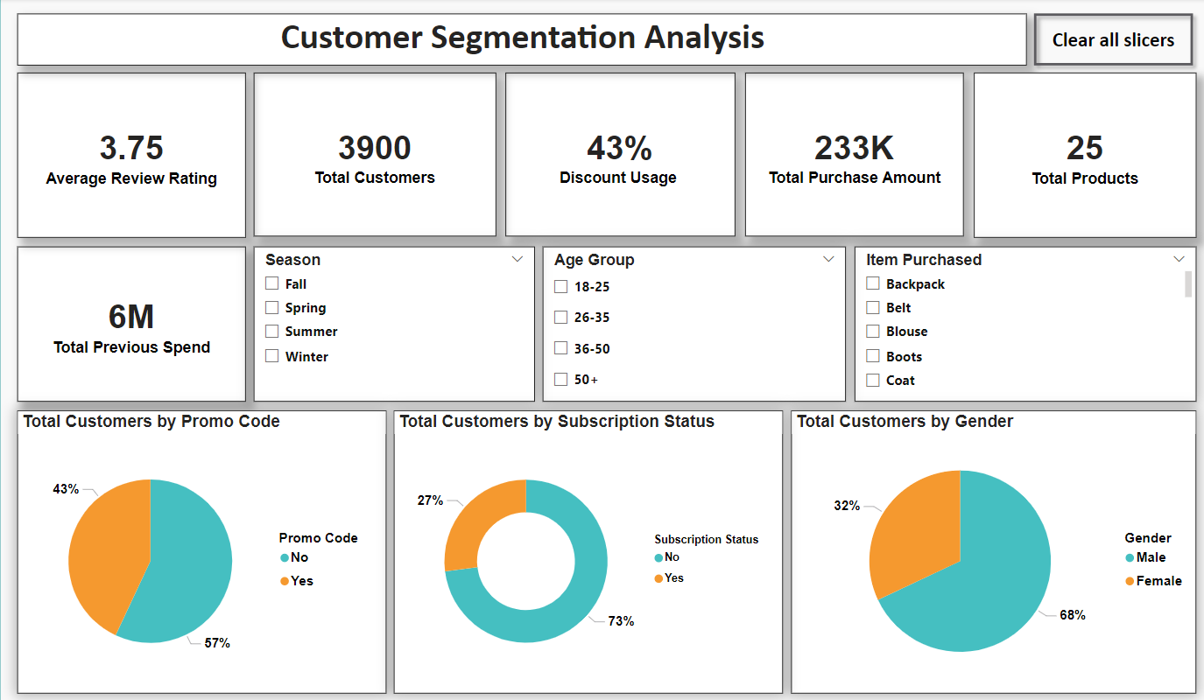
DASHBOARD
7

Slide 11
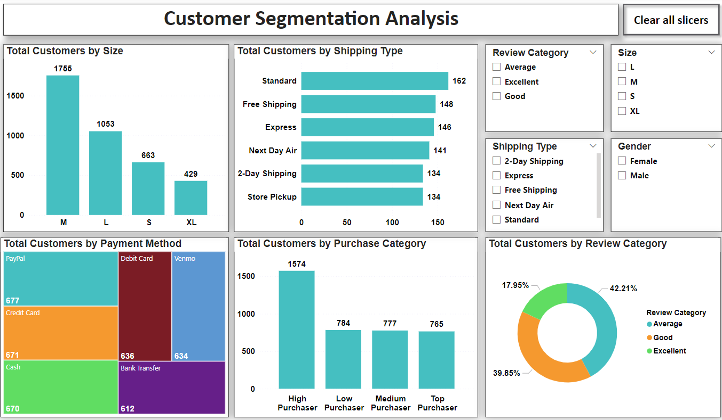
DASHBOARD
8

Slide 12
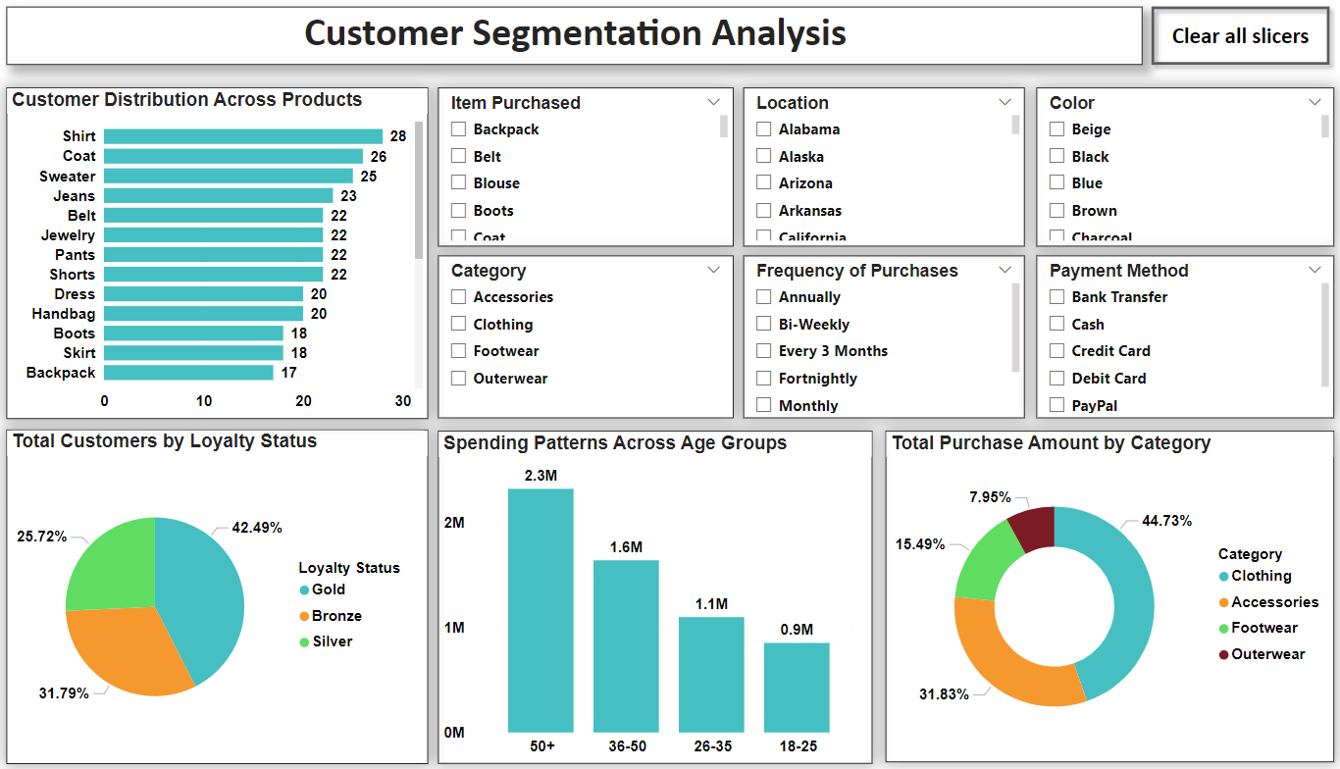
DASHBOARD
9

Slide 13
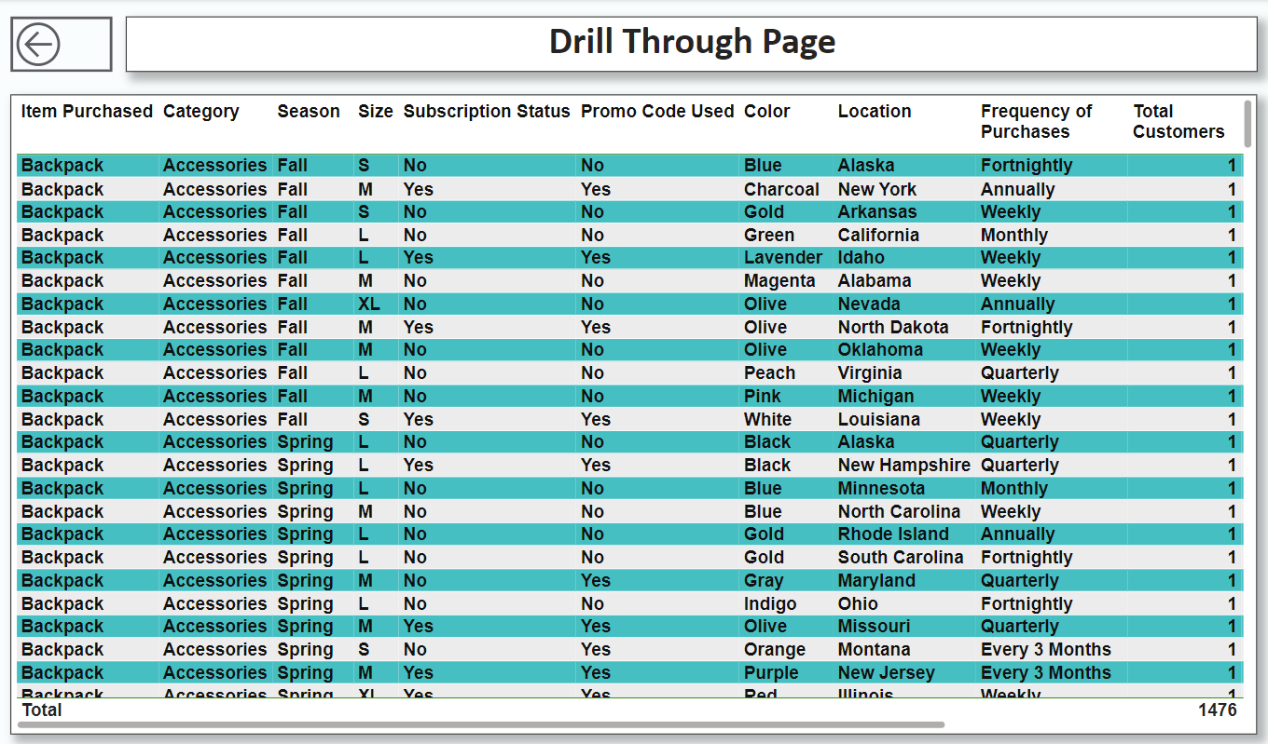
DASHBOARD
10

Slide 14

Key Insights
Most customers are male (68%) and use discounts (43%).
Clothing is the most popular category, while products like Backpacks and Skirts are less popular.
Most customers don’t use promo codes (57%) and a large portion are not subscribed (73%).
Customers prefer free shipping and standard shipping, while payment methods like PayPal and Credit Cards are the most popular.
Older customers (50+) spend more, while younger customers (18-25) spend less.
11

Slide 15
Summary of Key Metrics
Total Customers: 3900
Total Purchase Amount: 233K
Promo Code Usage: 57% of customers use promo codes.
Discount Usage: 43% of customers apply discounts.
Most Popular Category: Clothing (44.73% of total spend).
Preferred Shipping Method: Standard Shipping (162 customers).
Top Payment Method: PayPal (677 customers).
12

Slide 16
Conclusion
This analysis reveals key insights into customer shopping behavior, which can help in refining marketing strategies, improving customer experience, and driving sales.
The dashboard provides a comprehensive understanding of customer preferences, promotional impact, and purchasing patterns.
13

Slide 17

Thank you!

